Slide 1
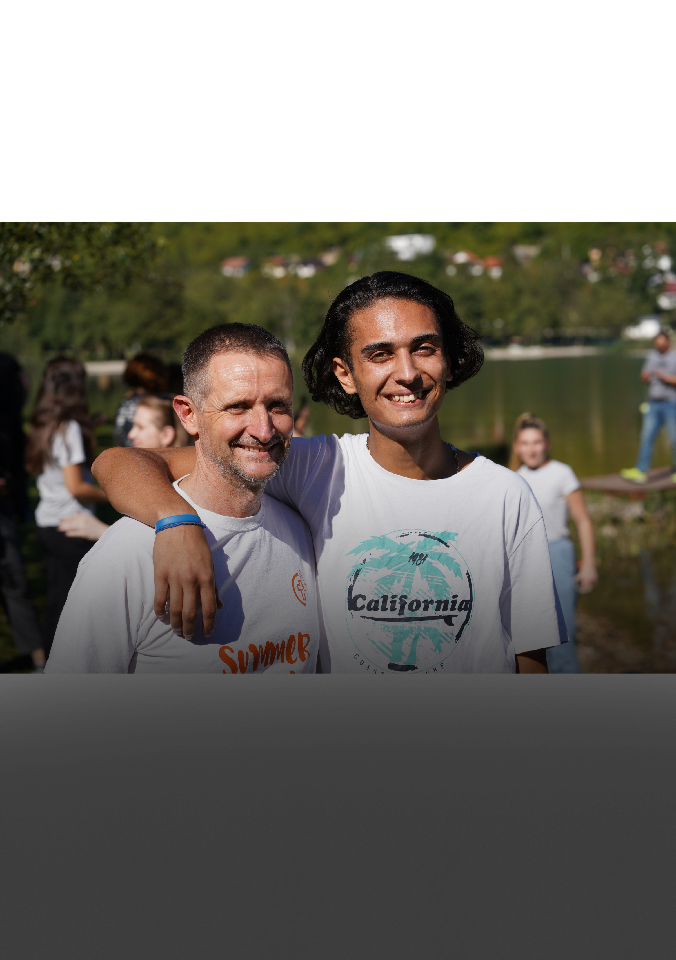

7 DAYS OF COURAGE

Slide 2
FAITH –vs- FEAR
WHAT PREVENTS PEOPLE FROM SHARING THEIR FATIH?
In the Jesus Film Project’s multi-generational survey on evangelism in 2020,
1600+ Christians were asked why they didn’t share their faith, and the
number one reason was fear. Overcoming fear is the biggest challenge and
there are ways you can gently build your courage and overcome your fear.

Slide 3
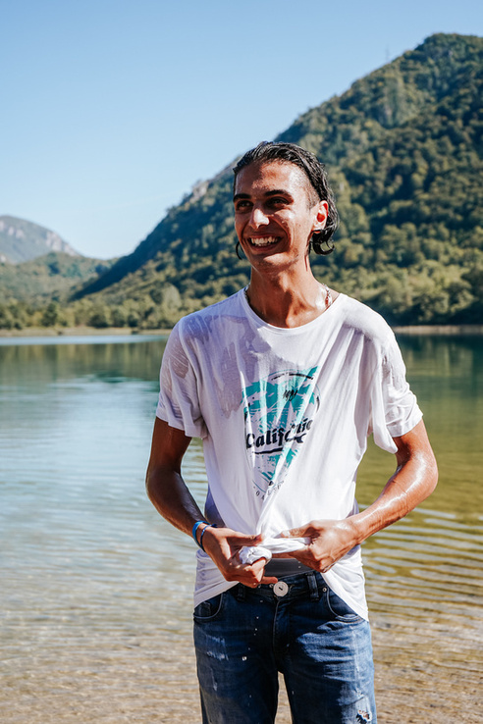
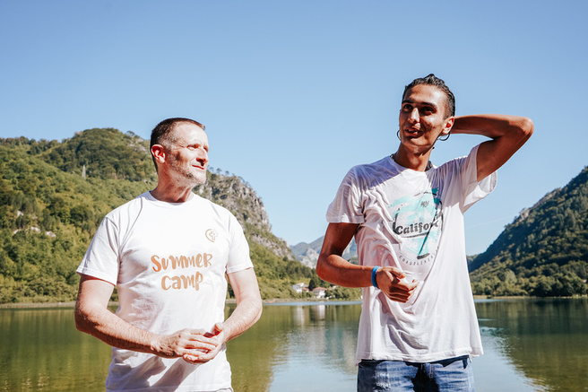
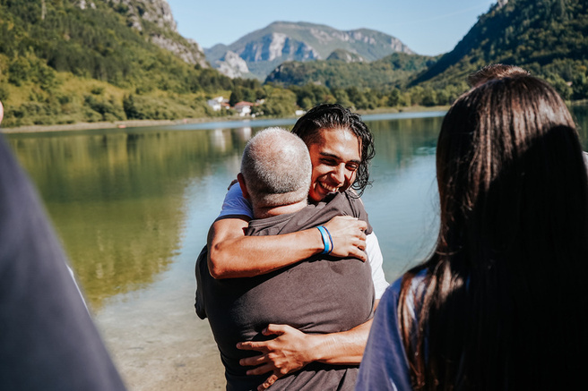
SIX STEPS
KEEP A RECORD
SHARE YOUR JOURNEY
Choose six steps from the provided “Steps of Courage” list and fill out the Steps of Courage participation card. Look to complete the se six steps over 7 days.
Keep updating your Steps of Courage card as you complete the challenge.
Keep a record of the challenges and outcomes of each step.
On Sunday, we encourage you to share your journey and some of the things God has done in your life during this time.

Slide 4
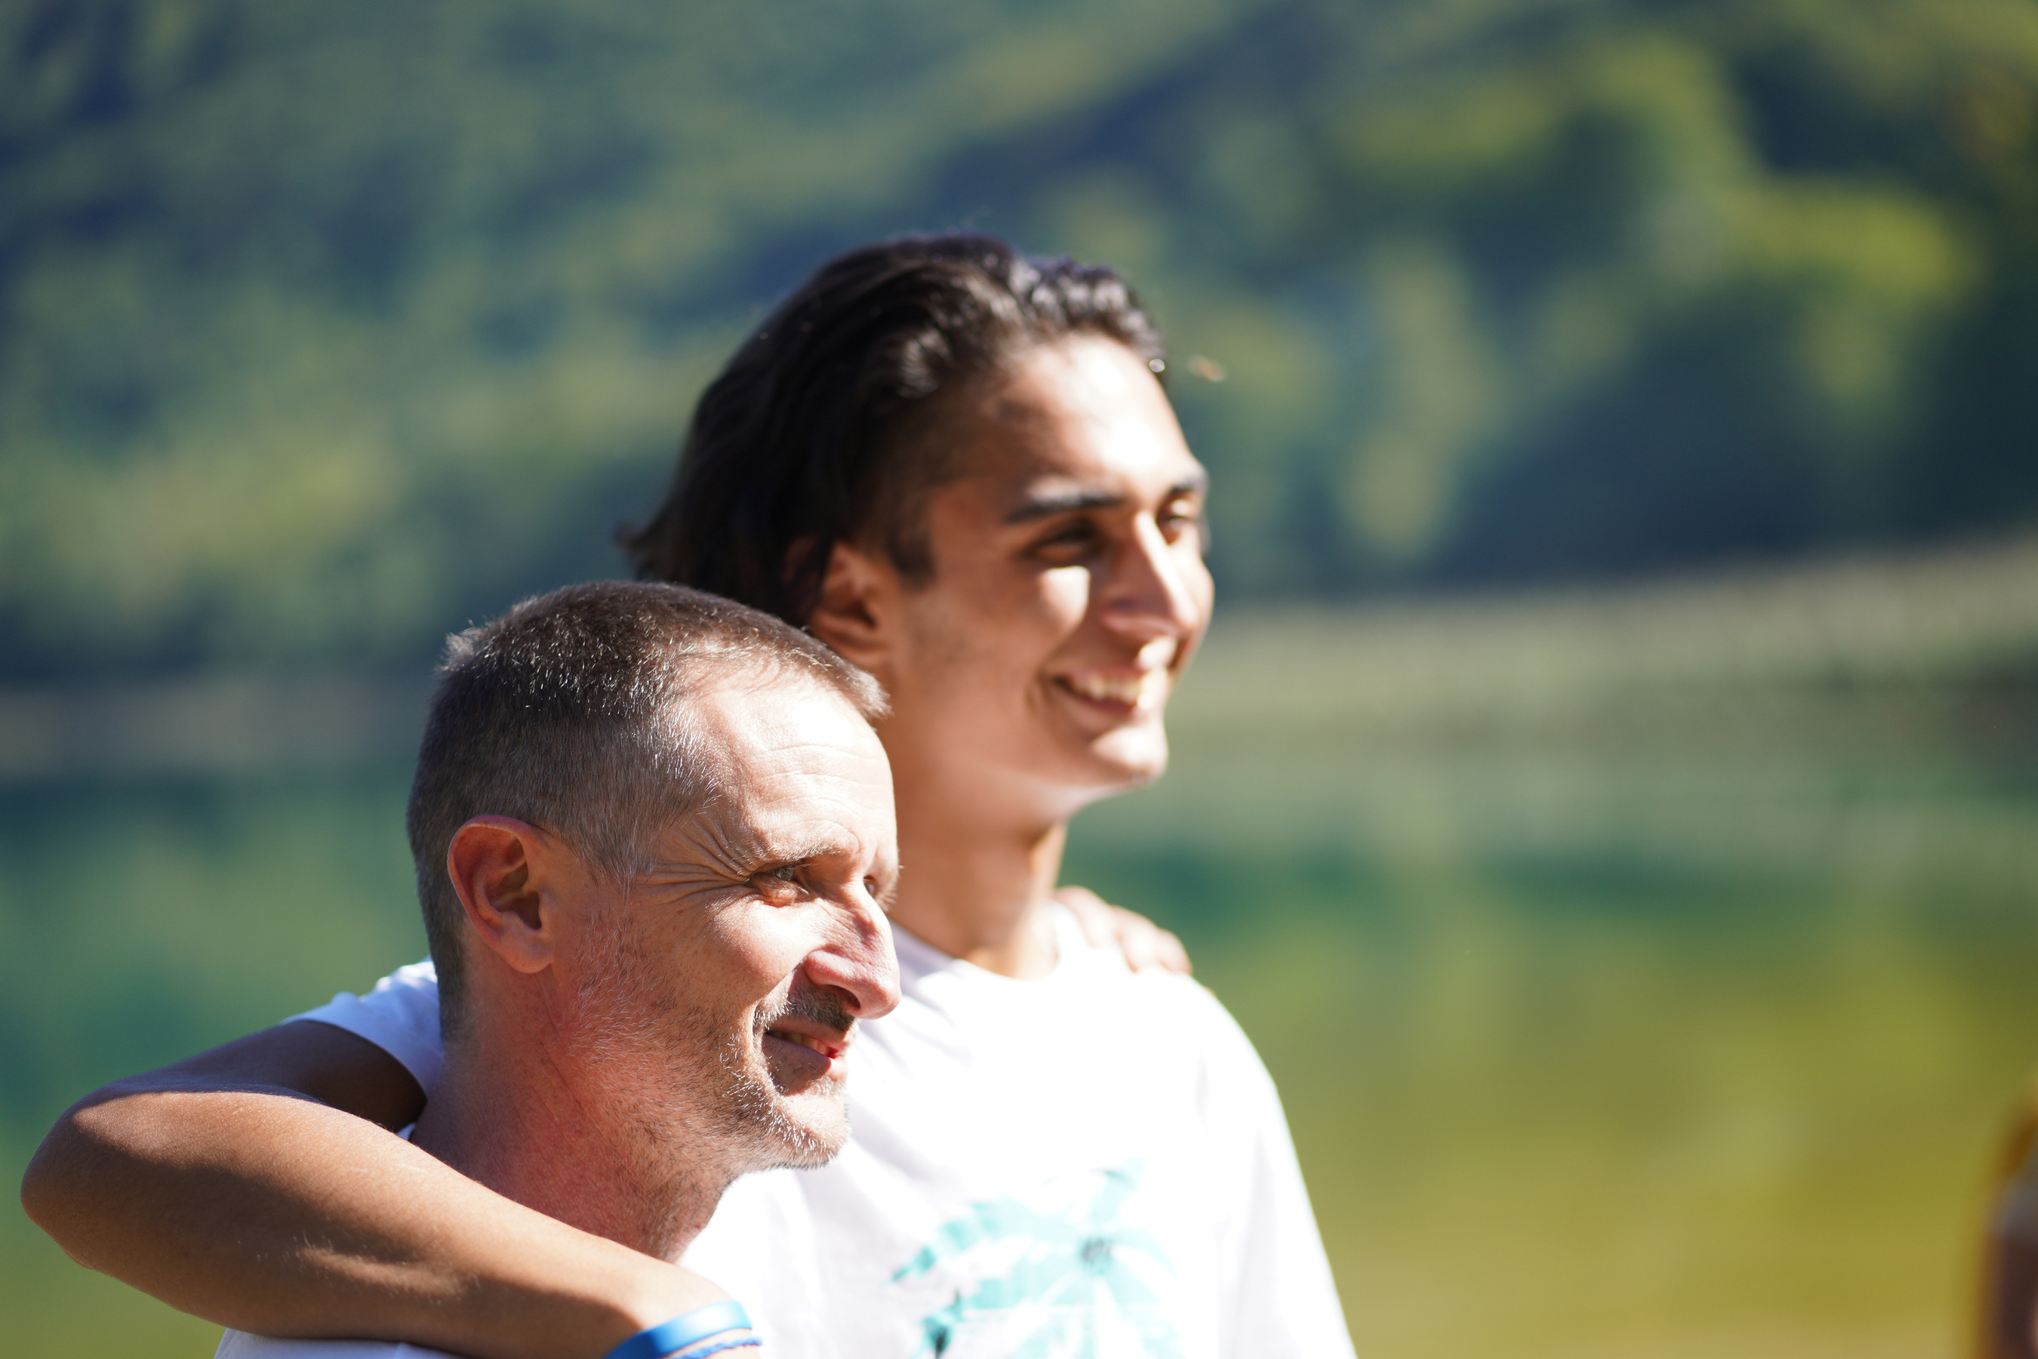
JOIN US!
WWW.MWBCA.ORG

